Slide 1
Kinetic Energy – May 20 (Energy Day 02)
Kinetic Energy
Presentation
Space Shuttle Columbia Case Study
Work-Energy Theorem
Presentation
Kinetic Energy Sample Problems
Kinetic Energy Homework Problems
DUE: Tuesday, May 24th
Upcoming:
Past Due: Friction Investigation

Slide 2
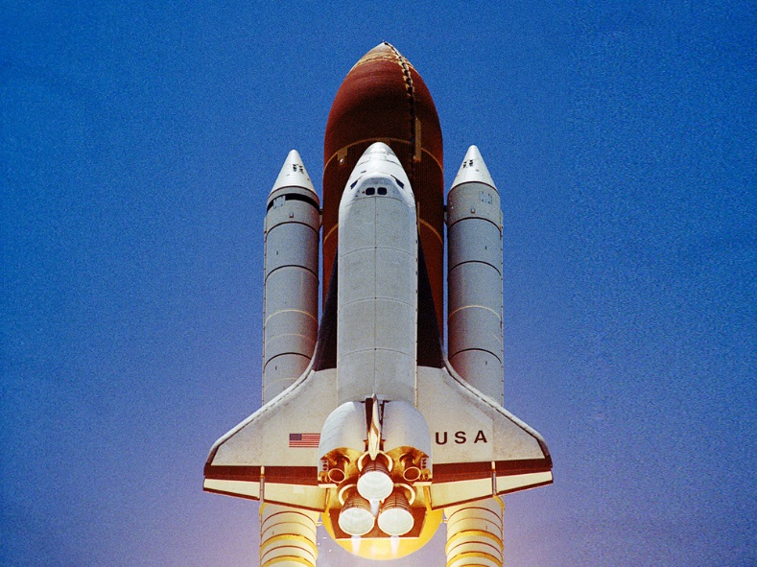
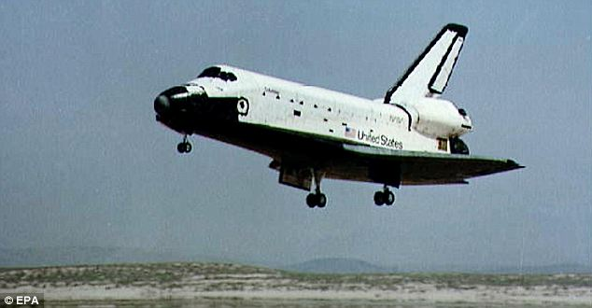
Space Shuttle Columbia

Slide 3
Columbia URLs
Breakup
https://www.youtube.com/watch?v=OZVBfiZvZos
Foam
https://www.youtube.com/watch?v=IgQ3ekcvyRA
BBC Part 2
https://www.youtube.com/watch?v=6R4ctaCBapM
BBC Part 3
https://www.youtube.com/watch?v=iJaSvssCiRM

